Slide 1
UNIT 1-PART 2 SYLLABUS
BASIC CONCEPTS OF LIFE CYCLE MODELS

Slide 2
Spiral model
Defined by Barry Boehm in his 1986 article "A Spiral Model of Software development and Enhancement“
The spiral model is similar to the incremental model, with more emphasis placed on risk analysis.
The spiral model has four phases: Planning, Risk Analysis, Engineering and Evaluation.
Spiral Model is a combination of a waterfall model and iterative model. Each phase in spiral model begins with a design goal and ends with the client reviewing the progress.

Slide 3
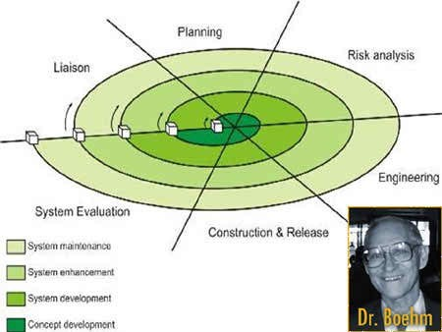
Spiral Model By Boehm

Slide 4
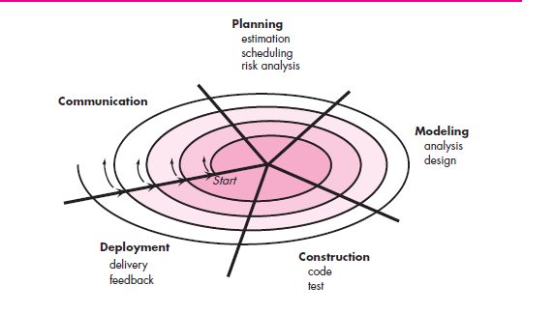

Slide 5
1.concept development
2.system development
3.system enhancement region
4.system maintenance

Slide 6
Spiral Model
Software project repeatedly passes through these four phases in iterations (called Spirals).
The baseline spiral, starting in the planning phase, requirements are gathered and risk is assessed. Each subsequent spirals builds on the baseline spiral
Both waterfall and prototype models are used in it.

Slide 7
Here we do software development systematically over the loops (adhering to waterfall approach) and at the same time we make a prototype and show it to user after completion of various phase (just in case of prototype model).
This way we are able to reduce risks as well as follow systematic approach

Slide 8
Phases
A spiral model has 4 phases described below:
Planning phase
Risk analysis phase
Engineering phase
Evaluation phase.

Slide 9
Planning
Requirements are studied and gathered.
Feasibility study
Reviews and walkthroughs to streamline the requirements
Requirements understanding document
Finalized list of requirements.
The project is reviewed and a decision made whether to continue with a further loop of the spiral.
If it is decided to continue, plans are drawn up for the next phase of the project

Slide 10
Risk Analysis
Requirements are studied and brain storming sessions are done to identify the potential risks
Once the risks are identified , risk mitigation strategy is planned and finalized
Document which highlights all the risks and its mitigation plans

Slide 11
Engineering phase
Actual development and testing if the software takes place in this phase
Code
Test cases and test results
Test summary report and defect report.

Slide 12
Evaluation
Customers evaluate the software and provide their feedback and approval
Features implemented document

Slide 13
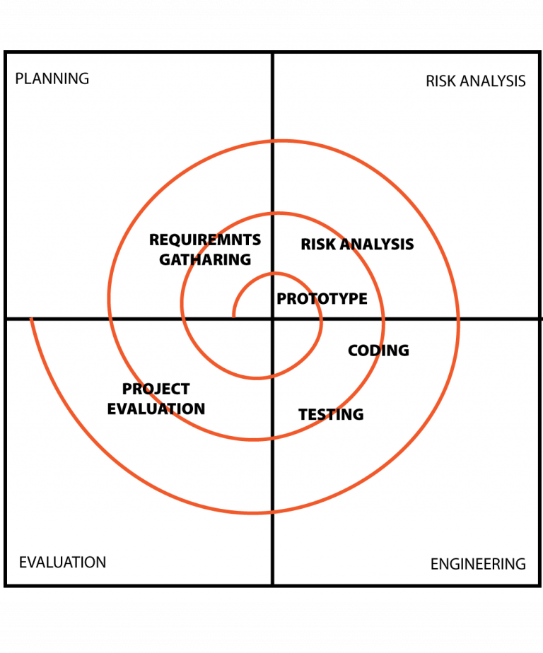

Slide 14
Comparison
Spiral Model
Waterfall model
Risk factors are considered.
The requirements are not freeze.
works in loop.
costly as Risk factor is covered.
Better communication between developer and customer.
Risk factors are not considered.
The requirements are freeze.
Is linear sequential model.
Not much costly.
Communication level is not high

Slide 15
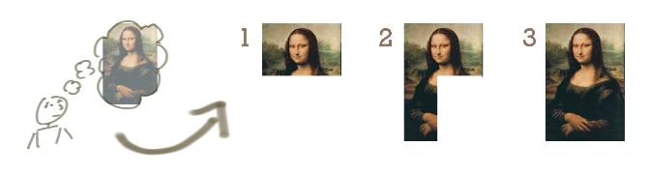
Incremental Model

Slide 16
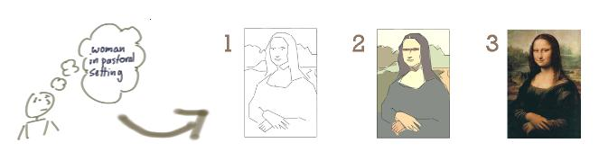
Evolutionary Model

Slide 17
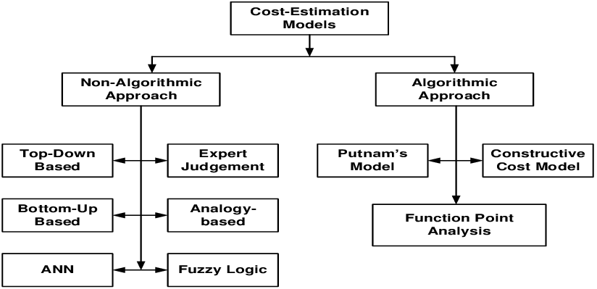
software cost estimation models

Slide 18
Milestones (Checkpoints) of the Process
It is important to have visible milestones in the life cycle , where
various stakeholders meet to discuss progress and planes.
The purpose of this events is to:
Synchronize stakeholder expectations and achieve concurrence on
the requirements, the design, and the plan.
Synchronize related artifacts .
Identify the important risks, issues, and out-of-tolerance conditions
Perform a global assessment for the whole life-cycle.

Slide 19
Milestones (Checkpoints) of the Process
Three types of joint management reviews are conducted
throughout the process:
Major milestones –These system wide events are held at the end of each development phase..
2. Minor milestones – These iteration-focused events are conducted to review thecontent of an iteration in detail and to authorize continued work.
3. Status assessments – periodic events provide management with frequent and regular insight into the progress being made.

Slide 20
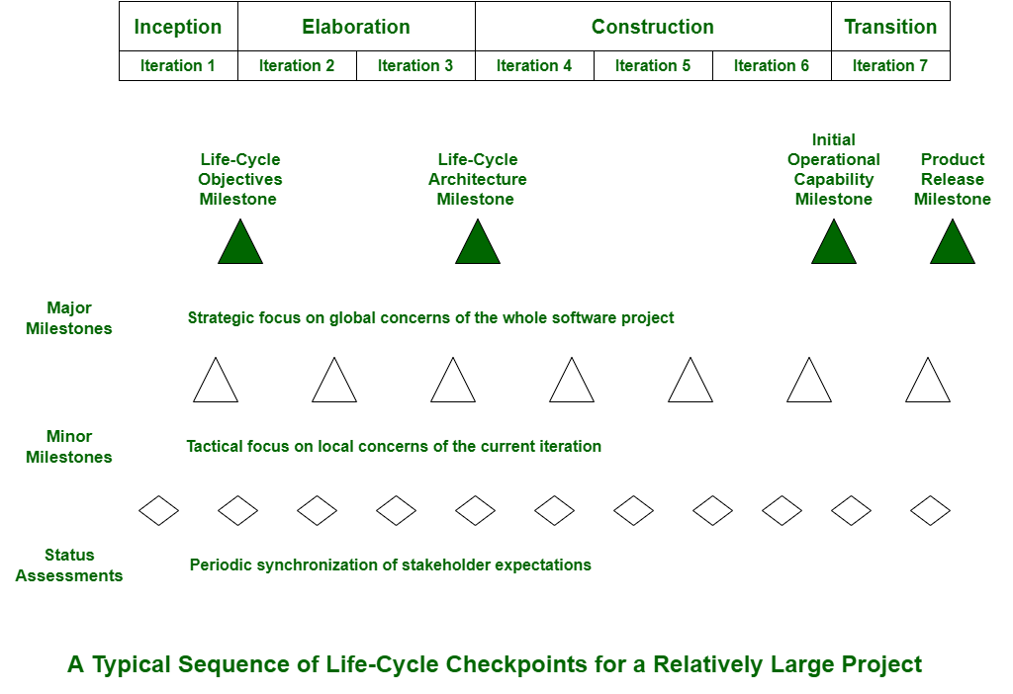

Slide 21
Project Controls
Project Control focuses on the factors that impact the schedule and budget of your project. It is a key factor in keeping your project running smoothly.
Project controls are a sub-function and focus on just two parameters: cost and schedule. People management and quality control, for example, does not fall under the purview of project controls.
The main objective of project controls is to minimize the variance in costs and schedule from what was originally planned.
Controls acts as a safety harness to project management. Sometimes project managers can focus almost solely on delivery, which leaves less room to examine costs, deviation from the project plan, and other variables involved. Project controls introduce a necessary reality check for project managers, giving a more data-grounded view of how the project resources and objectives are trending over time.

Slide 22

software project controls and reporting
Scope creep – resulting in blow-out of cost and schedule
Accuracy of estimations
Optimum team size to maximise productivity
The decision to employ phased development or single release
The choice of methodology – will this result in overall lower costs?
Impact on schedule when employing higher quality resources
Is the project suffering from “analysis paralysis”? What is the average time/cost for analysis phase?

Slide 23
Reports That Every Project Controls Team Should Have
1. Cost Report
One of the most frequently used tools for communication, a status report should include all metrics regarding project costs.
2. Change Management Register
Scope creep is a common challenge for most project managers. A change management register keeps track of change in scope from the initial statement of work or estimate. It identifies how much extra cost the project has to incur and how much the project may be delayed due to the addition in scope.
3. Risk Register
A risk register is a document that manages risks and records contingency .
It works as a RAID (risk, action, issues, decision) log and is created at the beginning of a project, documenting risks, assumptions, issues, and dependencies. As a project progresses, the risk factors can change, and these changes are tracked in the risk register.

Slide 24
SOFTWARE ECONOMICS
SOFTWARE ECONOMICS Most software cost models can be abstracted into a function of five basic parameters: size, process, personnel, environment, and required quality.
1. The size of the end product (in human-generated components), which is typically quantified in terms of the number of source instructions or the number of function points required to develop the required functionality
2. The process used to produce the end product, in particular the ability of the process to avoid nonvalue-adding activities (rework, bureaucratic delays, communications overhead)
3. The capabilities of software engineering personnel, and particularly their experience with the computer science issues and the applications domain issues of the project
4. The environment, which is made up of the tools and techniques available to support efficient software development and to automate the process
5. The required quality of the product, including its features, performance, reliability, and adaptability.

Slide 25
Improving the process
Meta process : An organization’s policies ,procedures and practices for pursuing a s/w intensive line of business. Focus is on organizational economics, long term strategies and ROI.
Macro process :A project’s policies ,procedures and practices for producing a complete s/w product with in certain cost,schedule, quality constraint .
Micro Process : A project team’s policies ,procedures and practices for achieving intermediate product of the s/w .

Slide 26

The relationships among these parameters and the estimated cost can be written as follows:

Slide 27
Concepts of Risk and its mitigation

Slide 28
Project Risks
What can go wrong?
What is the likelihood?
What will the damage be?
What can we do about it?

Slide 29
What Is Software Risk?
Risk is a potential problem that may or may not occur in the future. Risk is an expectation of loss.
A possibility of suffering from loss in software development process is called a software risk.
Loss can be anything, increase in production cost, development of poor quality software, not being able to complete the project on time.

Slide 30
Definition of Risk
A risk is a potential problem – it might happen and it might not
Two characteristics of risk
  Uncertainty – the risk may or may not happen.
  Loss – If the risk becomes a reality and unwanted consequences or losses occur

Slide 31
Risk Categorization
Project risks : Project risks threaten the project plan. That is, if project risks become real, it is likely that project schedule will slip and that costs will increase.
Technical risks :Technical risks threaten the quality and timeliness of the software to be produced. If a technical risk becomes a reality, implementation may become difficult or impossible.
Business risks :Business risks threaten the viability(working successfully) of the software to be built.

Slide 32
        Market risk
        Strategic risk
        Sales risk
        Management risk
        Budget risk
Known risks :Known risks are those that can be uncovered after careful evaluation of the project plan
Predictable risks:are extracted from past project experience (e.g., staff turnover, poor communication with the customer)
Unpredictable risks:They do occur, but they are extremely difficult to identify in advance.

Slide 33
Reactive vs Proactive risk strategy
Reactive
“Indiana Jones school of risk management”. “Don’t worry, I’ll think of something!”
  project team reacts to risks when they occur
  fix on failure—resource are found and applied when the risk strikes
  Proactive Risk Management
  A proactive strategy begins long before technical work is initiated
  Potential risks are identiﬁed, their probability and impact are assessed, and they are ranked by importance. Then, the software team establishes a plan for managing risk.

Slide 34
Assessing Risk Impact
Risk exposure, RE,
is determined using the following relationship [HAL98]:
RE = P x C
where P is the probability of occurrence for a risk, and C is the the cost to the project if the risk occur.

Slide 35
Impact values:
1—catastrophic
2—critical
3—marginal
4—negligible

Slide 36
Risk table
Risk | category | probability | Impact | RMMM (risk mitigation ,monitoring ,managing)

Slide 37
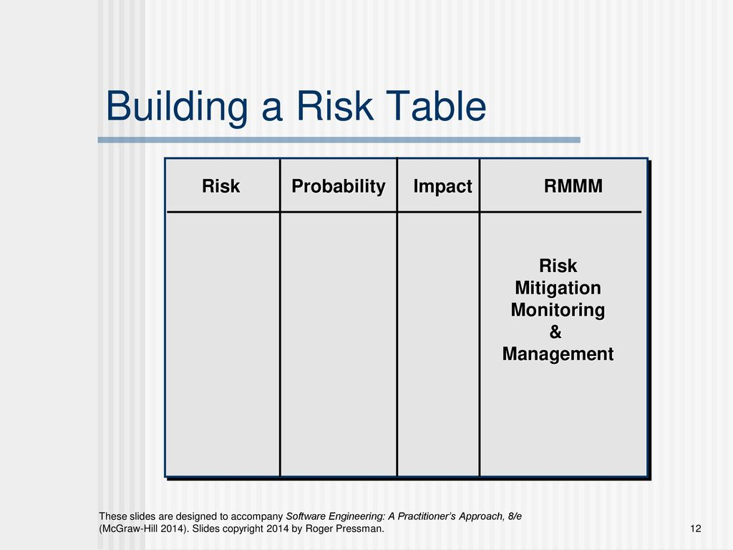

Slide 38
RISK MITIGATION, MONITORING, AND MANAGEMENT
Risk avoidance
Risk monitoring
Risk management and contingency planning

Slide 39
Steps for Risk Management
Identify possible risks; recognize what can go wrong
Analyze each risk to estimate the probability that it will occur and the impact (i.e., damage) that it will do if it does occur
Rank the risks by probability and impact
- Impact may be negligible, marginal, critical, and catastrophic
Develop a contingency plan to manage those risks having high probability and high impact

Slide 40
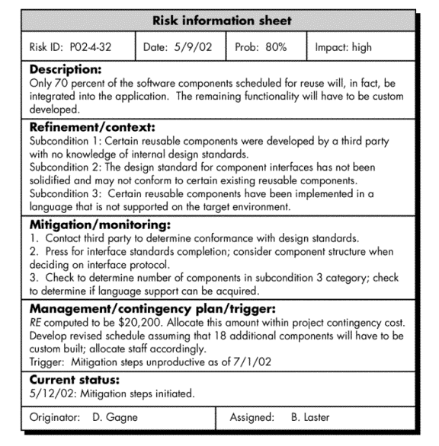
Risk Mitigation, Monitoring, and Management
(RMMM)

Slide 41
Questionnaire on Project Risk
Have top software and customer managers formally committed to support the project?
Are end-users enthusiastically committed to the project and the system/product to be built?
Are requirements fully understood by the software engineering team and its customers?
Have customers been involved fully in the definition of requirements?
Do end-users have realistic expectations?
Is the project scope stable?
(More on next slide)

Slide 42
Questionnaire on Project Risk (continued)
Does the software engineering team have the right mix of skills?
Are project requirements stable?
Does the project team have experience with the technology to be implemented?
Is the number of people on the project team adequate to do the job?
Do all customer/user constituencies agree on the importance of the project and on the requirements for the system/product to be built?

Slide 43
Risk Components and Drivers
The project manager identifies the risk drivers that affect the following risk components
  Performance risk - the degree of uncertainty that the product will meet its requirements and be fit for its intended use
  Cost risk - the degree of uncertainty that the project budget will be maintained
  Support risk - the degree of uncertainty that the resultant software will be easy to correct, adapt, and enhance
  Schedule risk - the degree of uncertainty that the project schedule will be maintained and that the product will be delivered on time
The impact of each risk driver on the risk component is divided into one of four impact levels
  Negligible, marginal, critical, and catastrophic
Risk drivers can be assessed as impossible, improbable, probable, and frequent

Slide 44
Risk mitigation (avoidance) is the primary strategy and is achieved through a plan.
Meet with current staff to determine causes for turnover (e.g., poor working conditions, low pay, competitive job market)
Mitigate those causes that are under our control before the project starts
Once the project commences, assume turnover will occur and develop techniques to ensure continuity when people leave
Organize project teams so that information about each development activity is widely dispersed
Define documentation standards and establish mechanisms to ensure that documents are developed in a timely manner
Conduct peer reviews of all Assign a backup staff members

Slide 45
During risk monitoring, the project manager monitors factors that may provide an indication of whether a risk is becoming more or less likely.
Risk management and contingency planning assume that mitigation efforts have failed and that the risk has become a reality
RMMM steps incur additional project cost
Risk is not limited to the software project itself
  Risks can occur after the software has been delivered to the user

Slide 46
The RMMM Plan
The RMMM plan may be a part of the software development plan or may be a separate document
Once RMMM has been documented and the project has begun, the risk mitigation, and monitoring steps begin
  Risk mitigation is a problem avoidance activity
  Risk monitoring is a project tracking activity
Risk monitoring has three objectives
  To assess whether predicted risks do, in fact, occur
  To ensure that risk aversion steps defined for the risk are being properly applied
  To collect information that can be used for future risk analysis
The findings from risk monitoring may allow the project manager to ascertain what risks caused which problems throughout the project
Notes:
(Paragraph 5.19.1)

